Slide 1
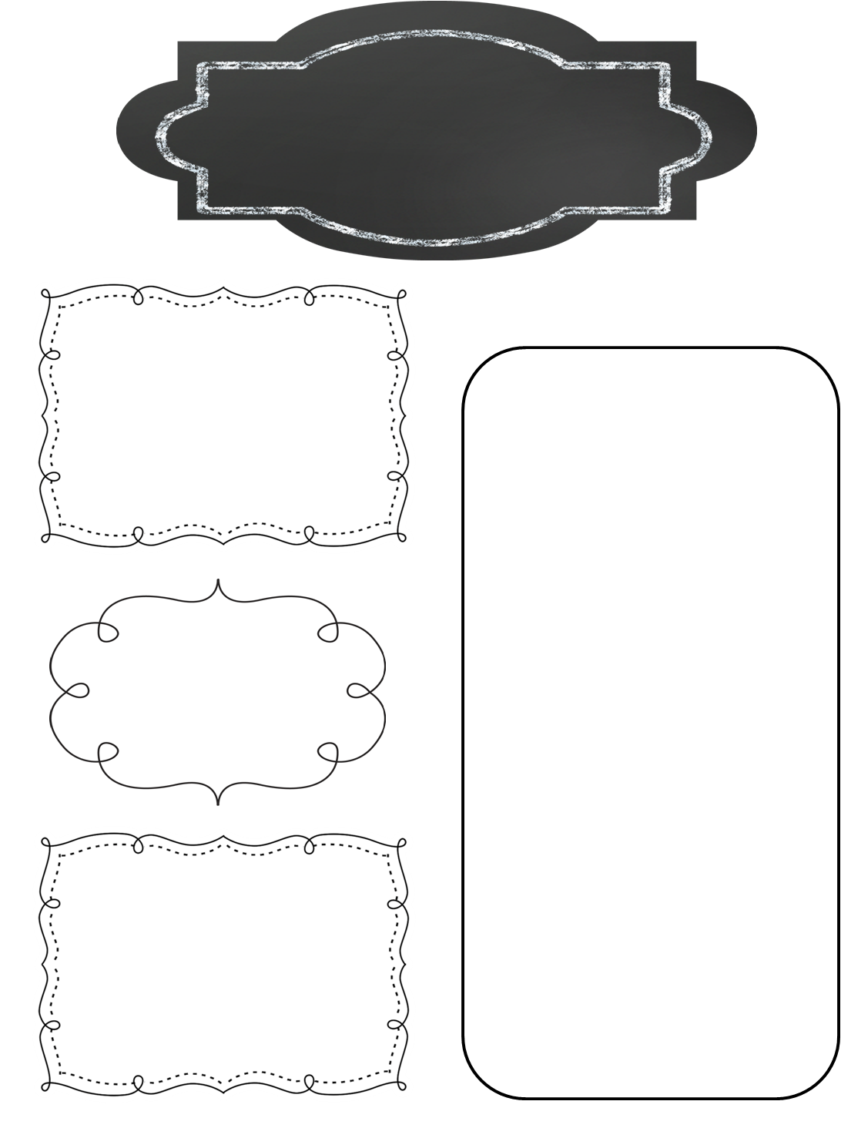
A Peek at This Week in…
Mrs. McFarland’s Class
Week of March 9th
Reminders
Our reading test format has changed as well. Our weekly tests will assess how well students have mastered the skills and strategies for the week, not the comprehension and vocabulary of the specific story read for the week. I will give the same grammar test because I want to be able to get a separate grammar grade.
Math (McFarland)
Ch. —9 Add and Subtract Fractions
Rounding Decimals
Adding and Subtracting fractions with common and uncommon denominators
IAR test practice
Reading (McFarland)
Unit 3, L#14 (See the skills & strategies sheets for the unit from last week.)
Tests tomorrow (Tuesday)!!
IAR test practice
A whole lot of homework is not getting completed by a lot of students. Please remind your student that homework is not optional...
IAR state testing begins next week. Please make sure your child in on time to school.
Spelling (McFarland)
VV pattern
Test this Tuesday (tomorrow)
Upcoming Events
Language Arts/Writing (McFarland)
Monday, March 16th: IAR testing begins and goes through the 23rd
Tuesday, March 17th: AR points due
Wednesday, March 18th: End of 3rd quarter
Wednesday, March 25th: Report cards available on line, NMSD board meeting 6:30 p.m.
Commas and semicolons
Daily Proofreading
Persuasive writing
Science/ Social Studies (Eldridge)
Science: Mystery Science
Social Studies: Ch. 9 test tomorrow

